Slide 1
Web Page Analysis
Microsoft teams learn web page
By: Blong Lor

Slide 2
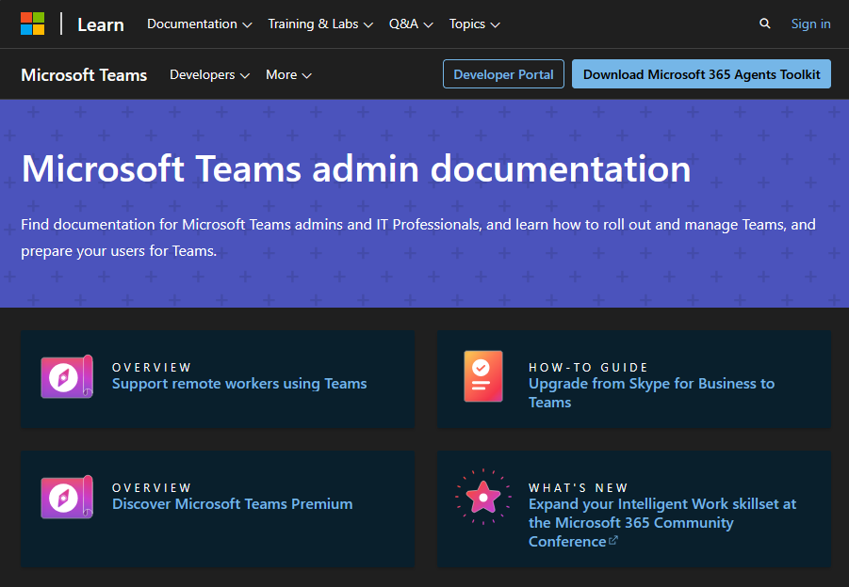
Introduction
https://learn.microsoft.com/en-us/microsoftteams/

Slide 3
Audience
Primary
Secondary
Microsoft Teams administrators
IT professionals
Developers
Anyone seeking to learn how to use Microsoft Teams

Slide 4
Purpose
Primary purpose
How to create Microsoft Teams
How to manage Teams
How to prepare users for Teams

Slide 5
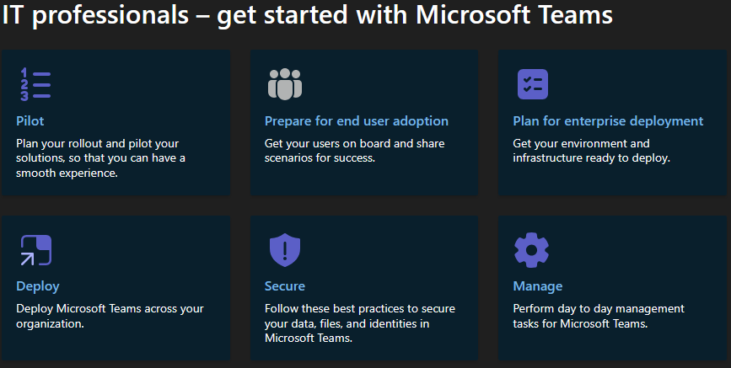

Slide 6
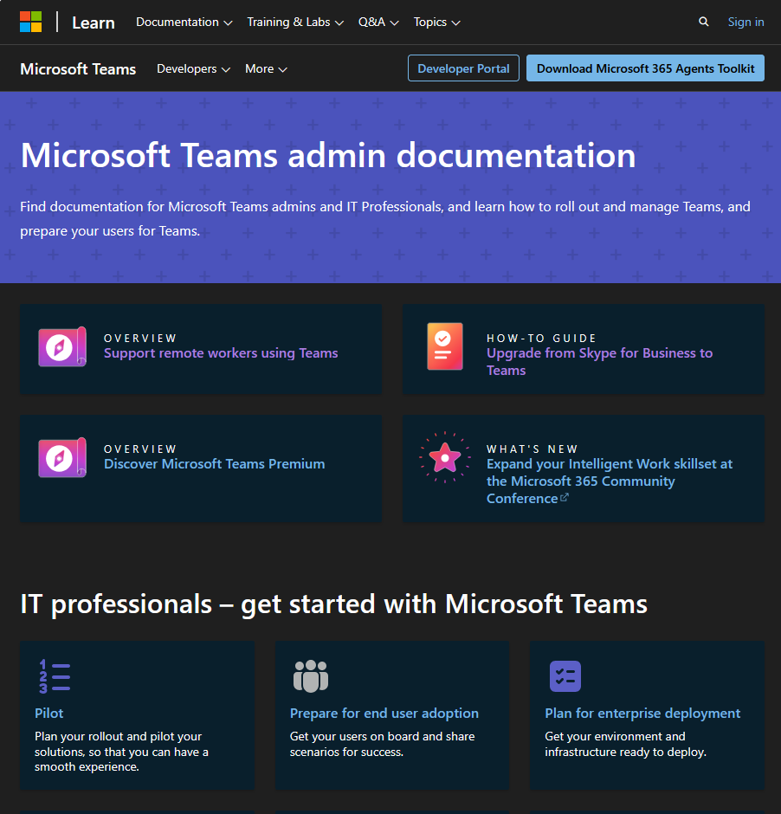
Web Page Design
Top bar and hubs beneath
Good use of white space and good readability
Multiple levels of headings and dark, toned-down colors
Non-excessive use of headings
Use of listing without bullets and numbers

Slide 7
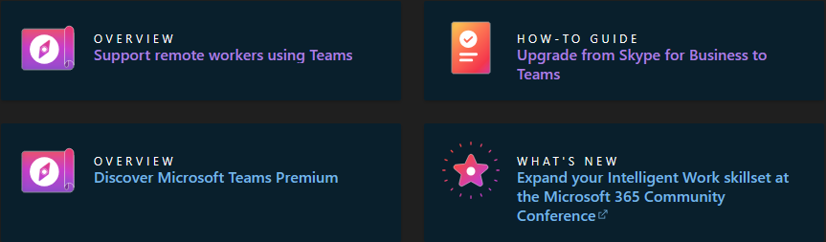
Use of Visuals
Non-excessive
Intuitive
Not excessively large
Colors are easy on the eyes

Slide 8
Web Page Ethics
Footer with information
Copyright Notice
Legal Disclaimers
Privacy Policy
Terms of Use
Contact Information

Slide 9
Conclusion
Microsoft teams learn web page is a good example of a well-designed web page
Easy navigation for core audience
Good use of sequencing, white space, font, color, and highlighting techniques
Non-excessive visuals that are intuitive
Ethical with a proper footer at the bottom

Slide 10
Sources
Course material
Tebeaux, Elizabeth, and Sam Dragga. The Essentials of Technical Communication. Available from: Insite, (5th Edition). Oxford University Press Academic US, 2020.
Web material
samanro. “Microsoft Teams Admin Documentation - Microsoft Teams.” Learn.microsoft.com, learn.microsoft.com/en- us/microsoftteams/.

